Slide 1
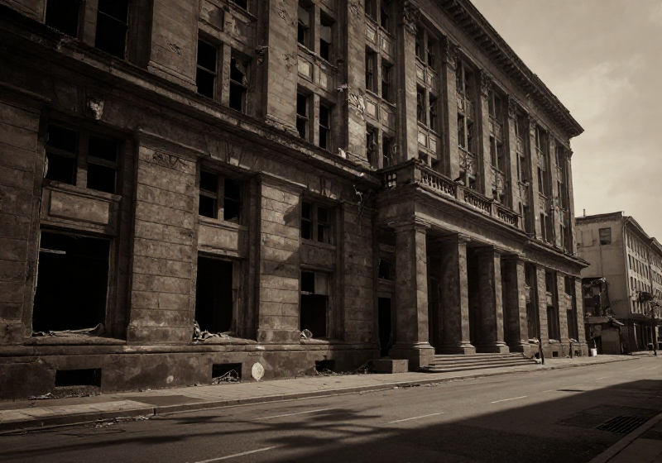

CORRUPTION
CREATED BY:LINDA LUCHIRI DATE: March-2026
Overview of the topic

Slide 2
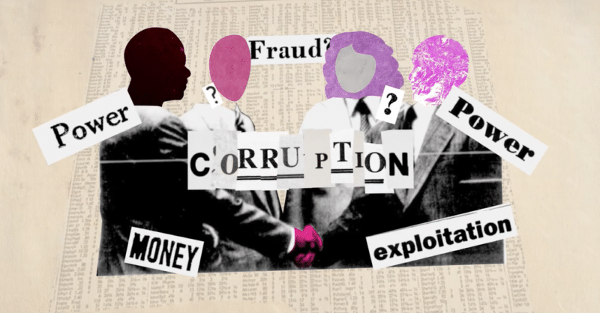
Introduction and Definition
CREATED BY: LINDA LUCHIRI DATE: March-2026
A comprehensive overview of key concepts and definitions.
This Photo by Unknown Author is licensed under CC BY

Slide 3

Question: What are the impacts of corruption?
CORRUPTION
Impact Overview
It causes market distortion because success depends on political connections rather than quality of products or service.
It makes the country to have poor development and poor building of infrastructure which leads to reduced foreign investment.
It causes erosion or decay of trust
It causes inequality public services due to bribes.
It brings about brain drain where talented individuals seek job offers or opportunities in other countries.
It causes civil unrest.
It leads to organize crime e.g. money laundering or human trafficking.
It causes weakened institutions like police, judiciary or regulatory bodies.

Slide 4

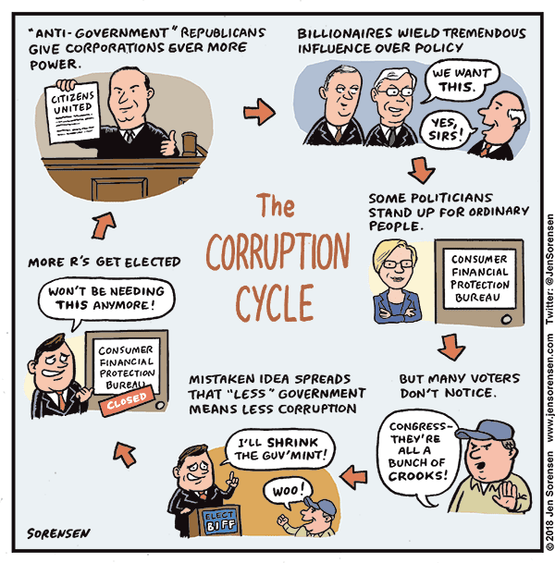
Define: corruption as the abuse of entrusted power for private gain.
CREATED BY: LINDA LUCHIRI DATE: 3/17/2026
Core definition and overview

Slide 5
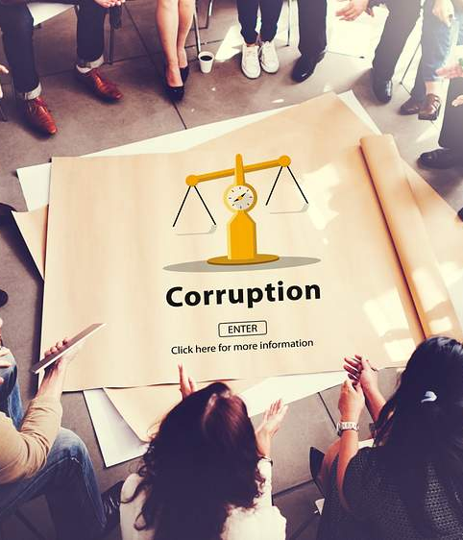
Forms of corruption: Distinguish between Grand (high level policy distortion) and Petty (small bribes in daily life ) corruption.
Define: corruption as the abuse of entrusted power for private gain.
Grand corruption
Petty corruption
Grand corruption occurs at high levels of government or public office and involves major distortions of policies, institutions, and legal frameworks. It typically affects public resources and decision-making on a large scale, undermining trust in institutions and causing wide-reaching economic and social harm.
Petty corruption involves small-scale transactions such as everyday bribes, facilitation payments, or minor abuses of power by lower-level officials. While individually small, petty corruption is pervasive and erodes public services, increases costs for citizens, and normalizes corrupt practices.

Slide 6
Types :Briefly explain bribery ,embezzlement, nepotism/cronyism, extortion and money laundering.
Define: corruption as the abuse of entrusted power for private gain.
Bribery
Embezzlement
Nepotism / Cronyism
Extortion
Money laundering
Nepotism and cronyism occur when people in power favor relatives, friends, or associates for jobs, contracts, or benefits regardless of merit. These practices weaken institutions, reduce efficiency, and deny opportunities to qualified individuals.
Bribery involves offering, giving, receiving, or soliciting something of value to influence the actions of an official or other person in a position of trust. It can take many forms, from cash payments to gifts, favors, or promises, and undermines fair decision-making.
Embezzlement is the theft or misappropriation of funds placed in one's trust or belonging to an organization. Perpetrators divert money or assets for personal use, often through falsified records or abuse of financial controls.
Extortion involves coercing individuals or organizations to give up money, property, or services through threats, intimidation, or abuse of authority. It often forces victims to pay for protection or to avoid harm, creating an environment of fear and dependency.
Money laundering is the process of concealing the origins of illegally obtained funds to make them appear legitimate. It typically involves multiple transactions, transfers across jurisdictions, and complex financial instruments to obscure the money trail and integrate illicit proceeds into the formal economy.

